Slide 1
POTATO VARIETIES IDENTIFICATION USING IMAGE CLAASIFICATION
Submitted by
Debraj Ghosh-10200222066
Rahul Das-10200222070
Guided by
Dr. Satyendranath Mandal
Assistant Professor in Dept. of Information Technology
Kalyani Government Engineering College

Slide 2
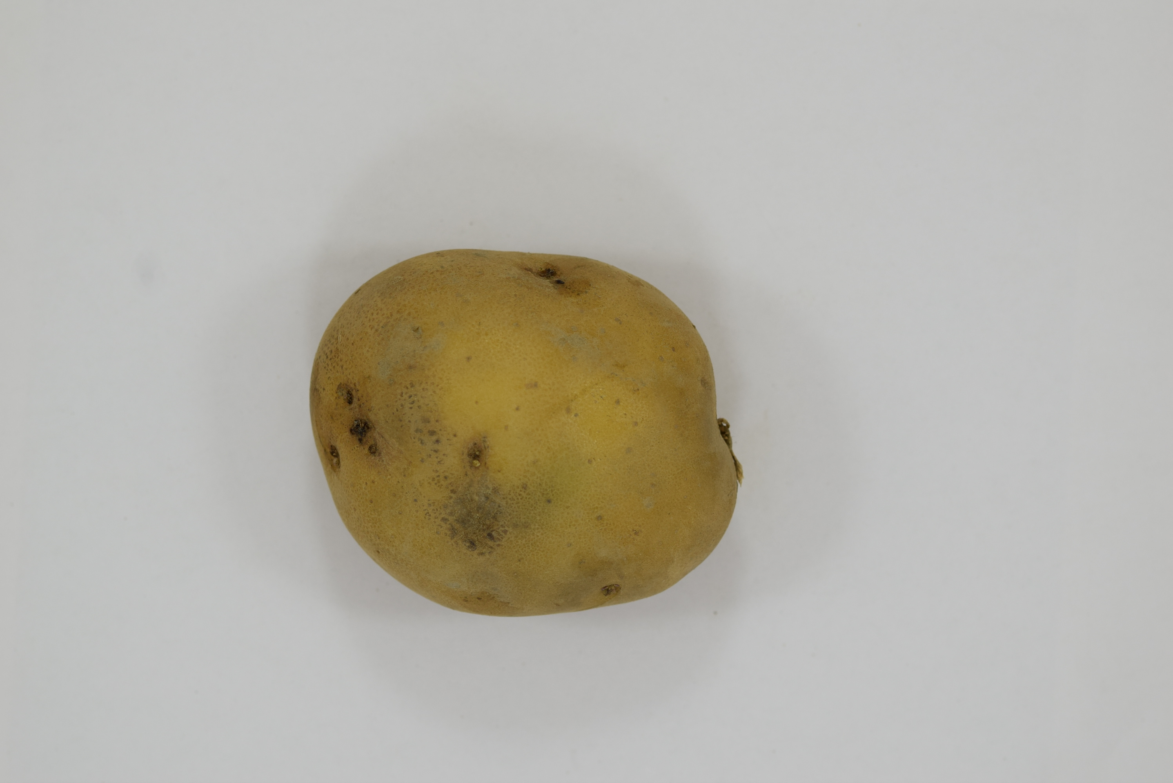
Abstract
The Potato Identification System is an advanced AI-driven solution designed to classify potato breeds with high accuracy by analyzing image data. Utilizing Convolutional Neural Networks (CNNs) and texture analysis through Gray Level Co-occurrence Matrices (GLCM), the system automates the traditionally manual task of potato breed identification, significantly enhancing efficiency and precision. This project addresses key challenges faced in agriculture, such as quality control, breed-specific disease detection, and scalability in operations.
The system workflow includes image preprocessing, feature extraction, model training, and real-time prediction. Preprocessing ensures uniformity in input data, while CNNs extract breed-specific patterns for classification. Haralick features derived from GLCM offer additional insights into potato textures, enhancing model performance. By leveraging data augmentation and scalable architectures, the system achieves robust generalization across varying conditions.
This system provides an innovative approach to agricultural automation by reducing dependency on human expertise, improving decision-making in the supply chain, and ensuring consistent quality grading. Deployed as a standalone application or integrated with IoT devices, the Potato Identification System holds significant potential to revolutionize modern farming practices.

Slide 3
Introduction
The classification of potato tuber varieties is a critical aspect of agricultural research and practice, allowing for accurate identification and differentiation of potatoes based on their physical and textural characteristics. This project presents a comprehensive approach to developing a classification system for potato tuber varieties, integrating both traditional feature extraction methods and modern deep learning techniques. The system is designed to train on a dataset of potato tuber images by extracting key features, including texture, color histograms, and shape descriptors, which form the foundation for subsequent predictions. By leveraging these features, the system is capable of testing new images and predicting their variety with high accuracy, guided by the knowledge derived from the training data.
The training process involves organizing the dataset into classes representing different potato varieties and preprocessing the images to extract meaningful information. Traditional features such as texture properties derived from the Gray-Level Co-occurrence Matrix (GLCM), color distribution represented through histograms, and shape features like area and circularity are calculated. Simultaneously, a Convolutional Neural Network (CNN) is employed to extract high-level patterns from the images. These two streams of information are fused in a hybrid model architecture that combines the strengths of handcrafted features and deep learning, enabling robust classification of potato varieties.

Slide 4
Workflow Of The Project
Data collecting(Potato images)
Divide the data for training and testing(80/20)
Build a Web application app using HTML,CSS,Flask
Train the model using 80% of the data
Test the model using 20% of the data

Slide 5
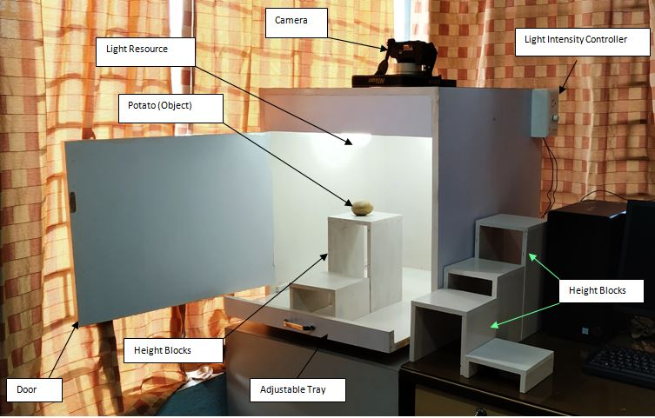
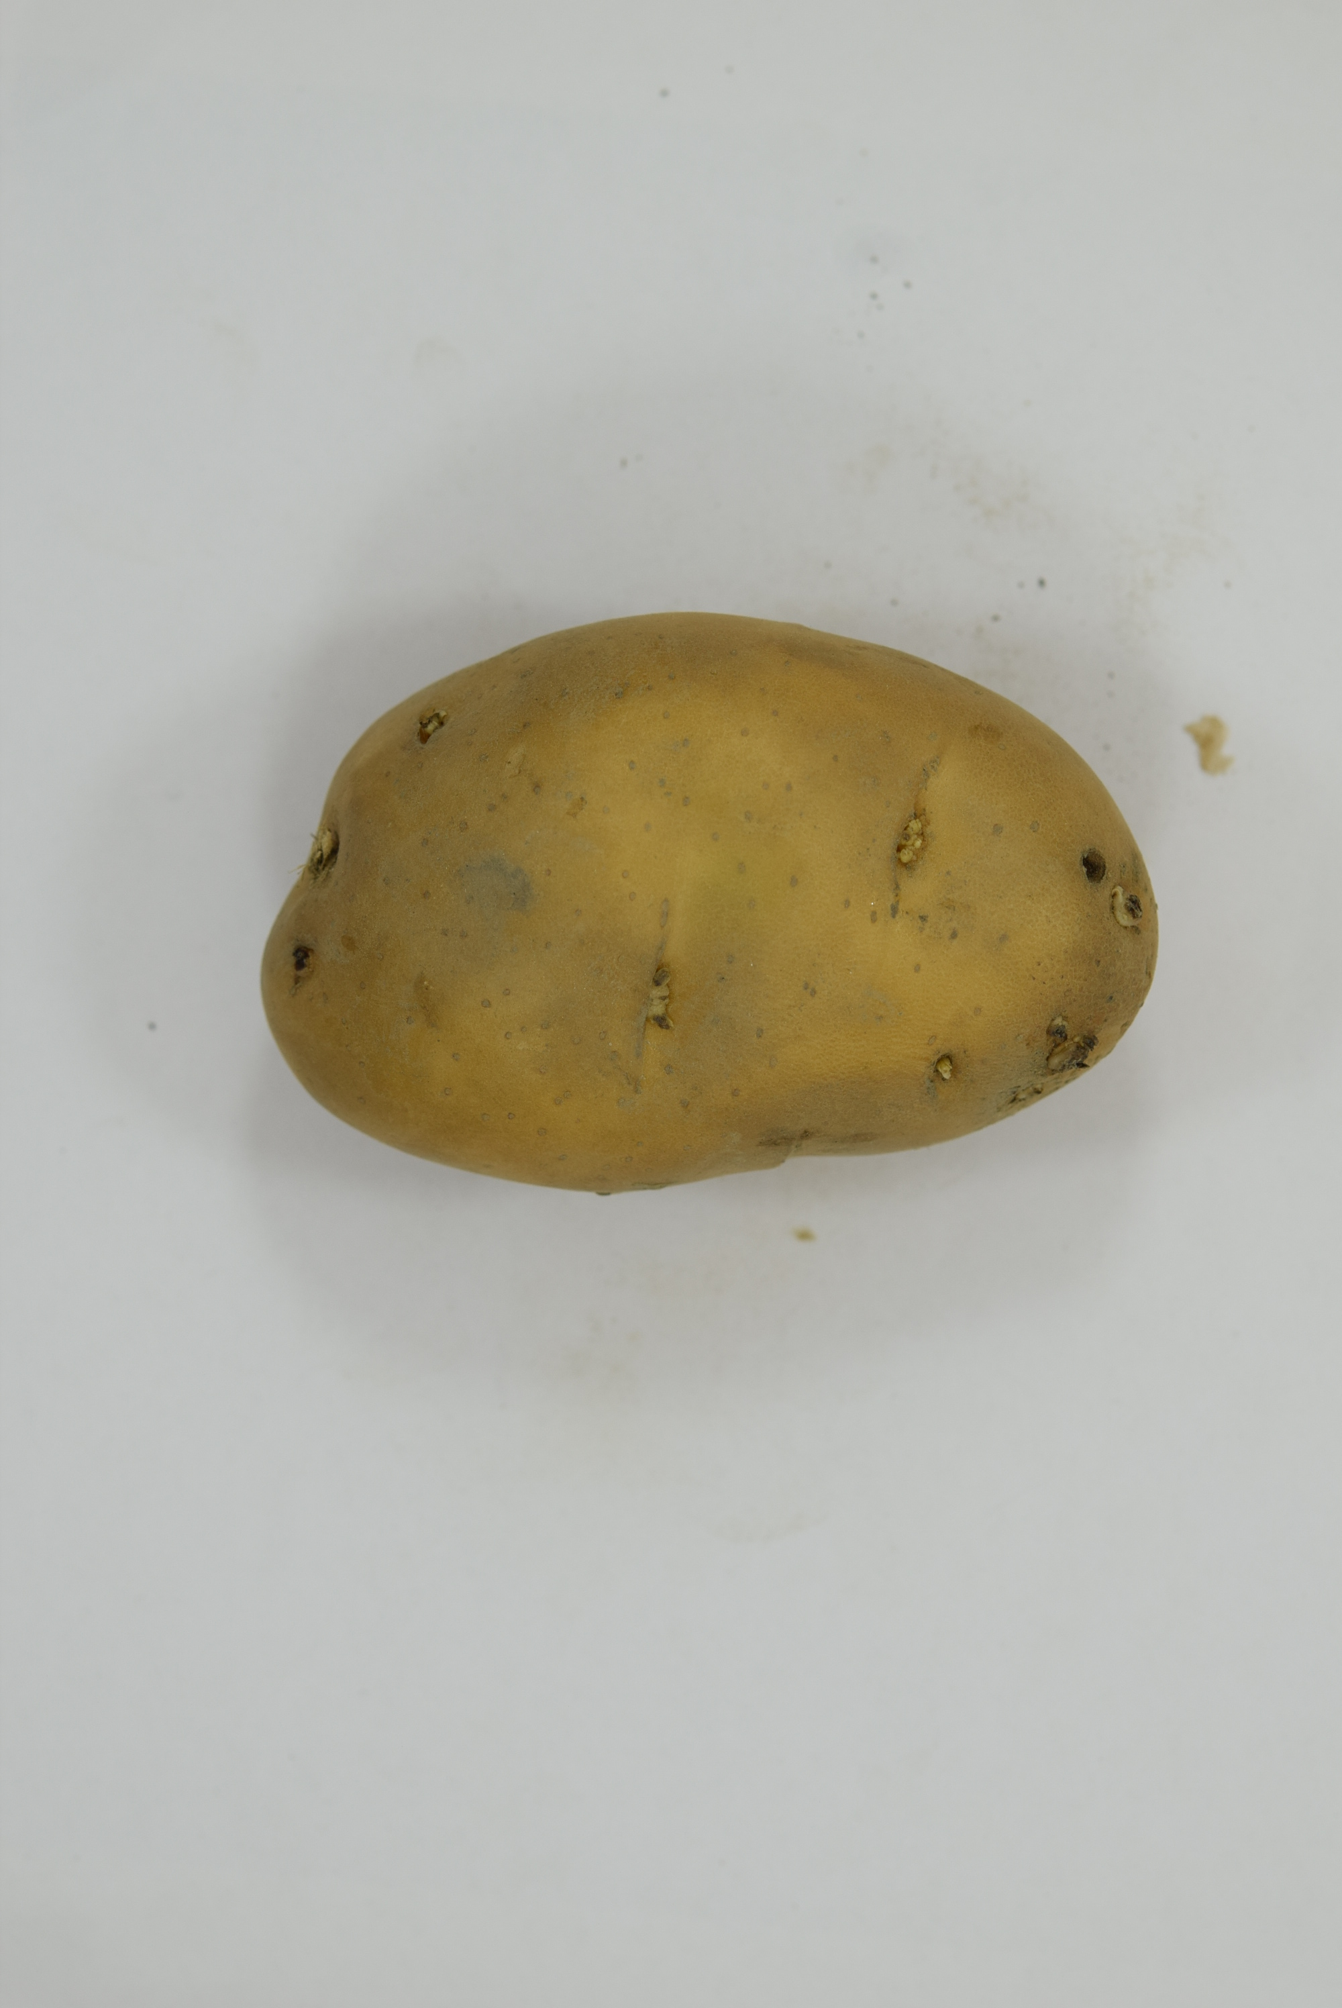
Potato Image Capture Setup
Result

Slide 6
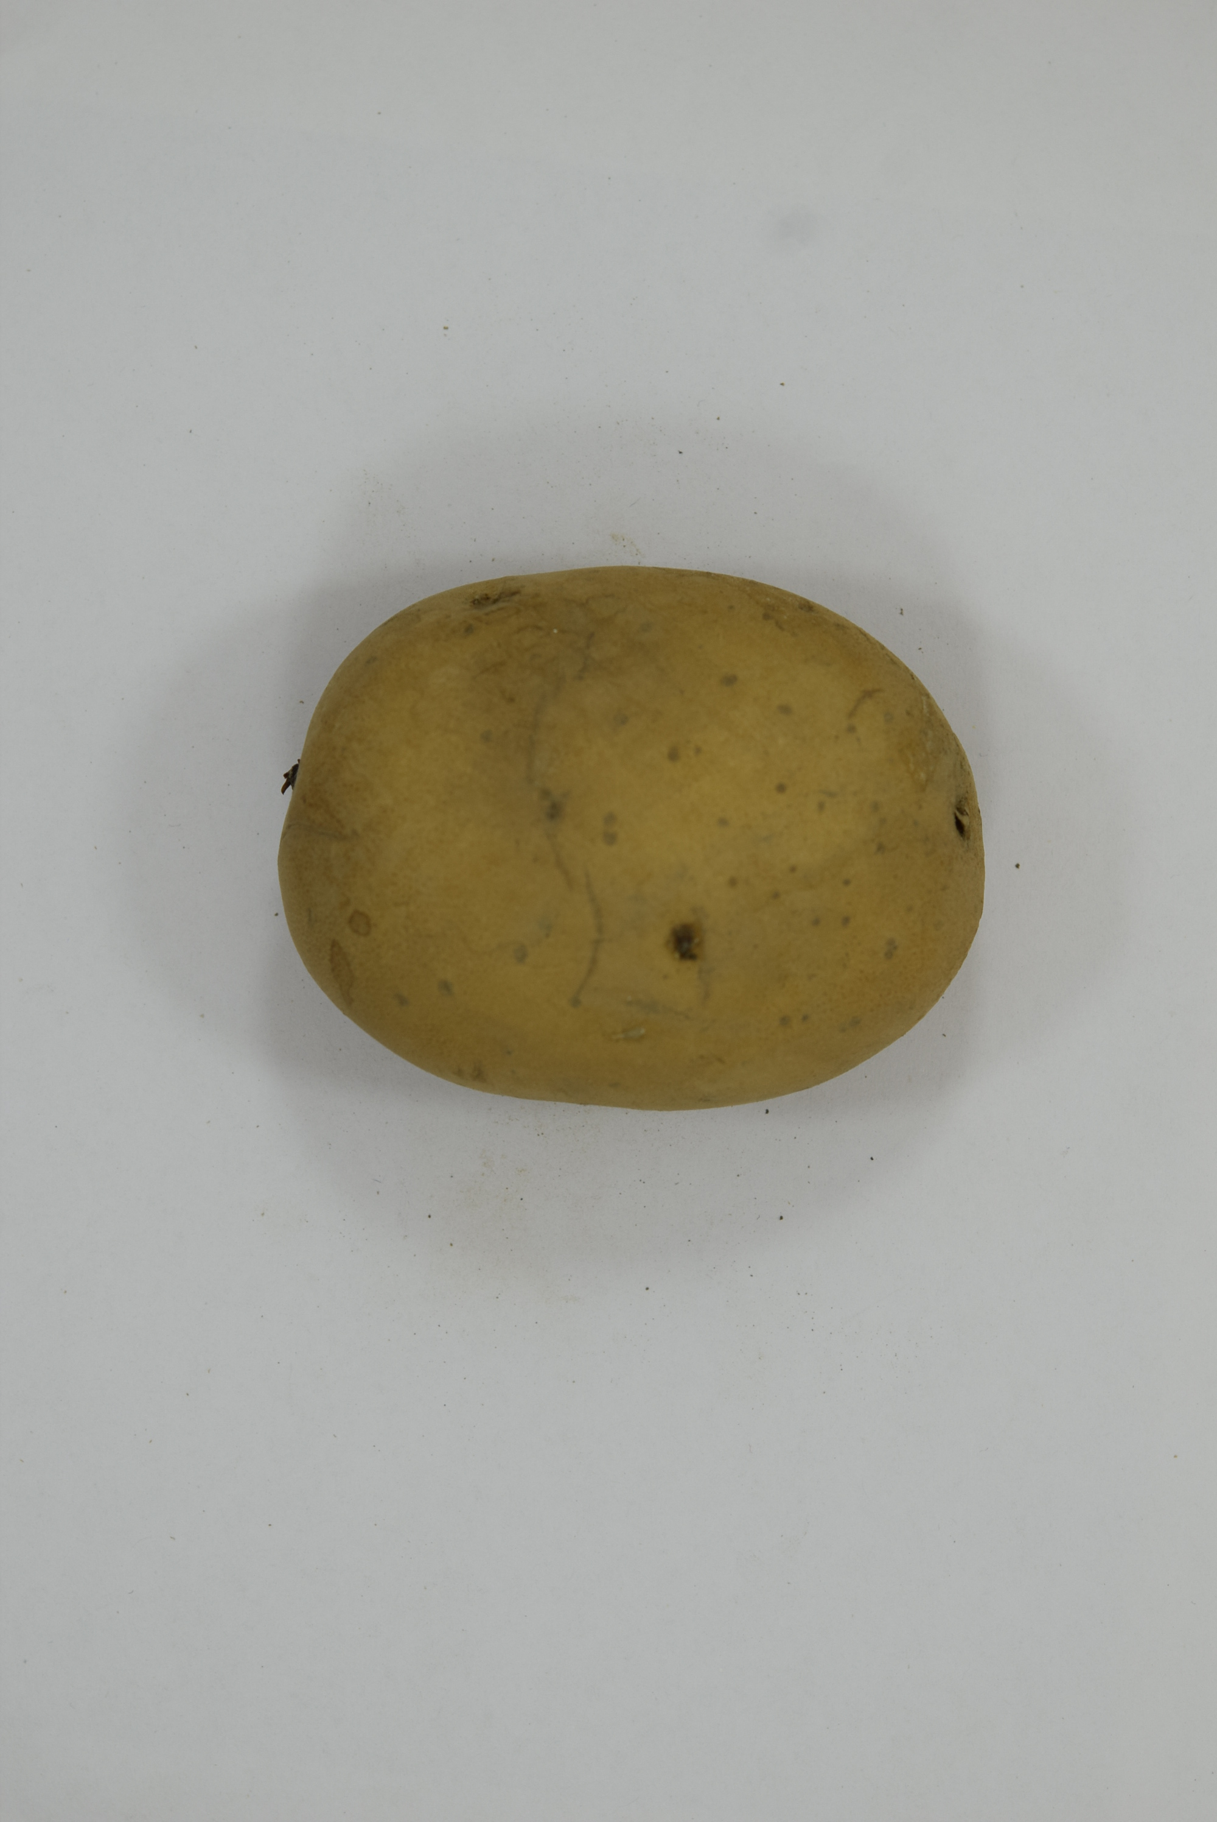
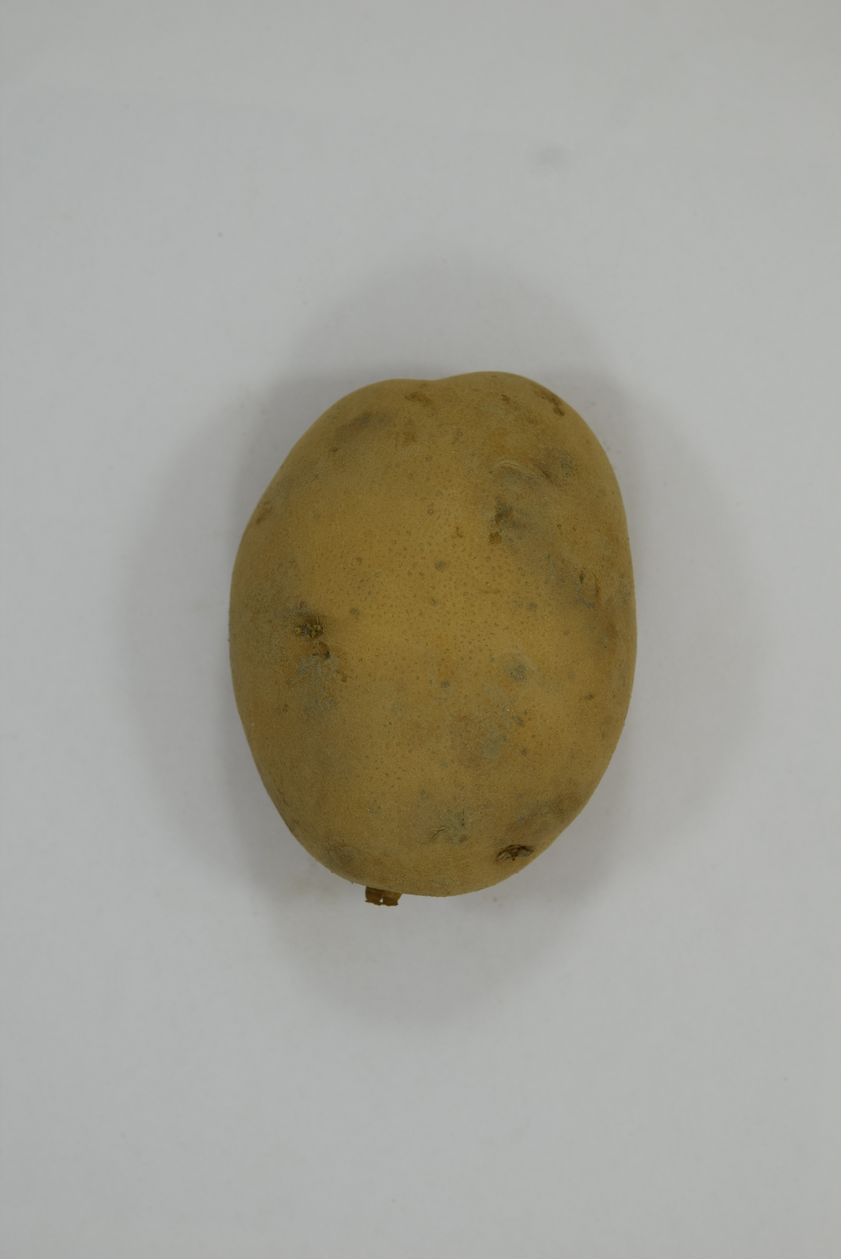
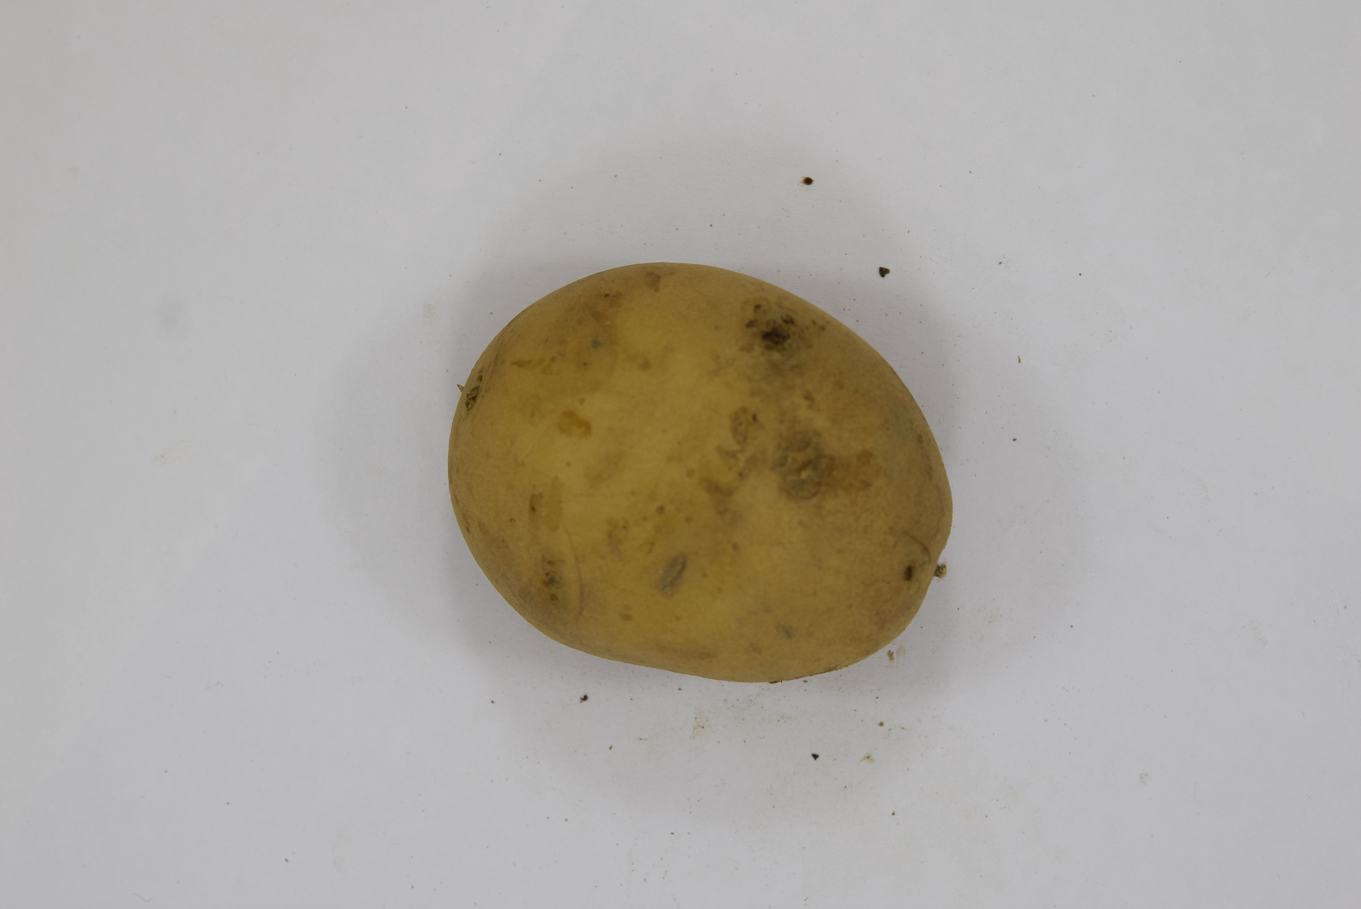
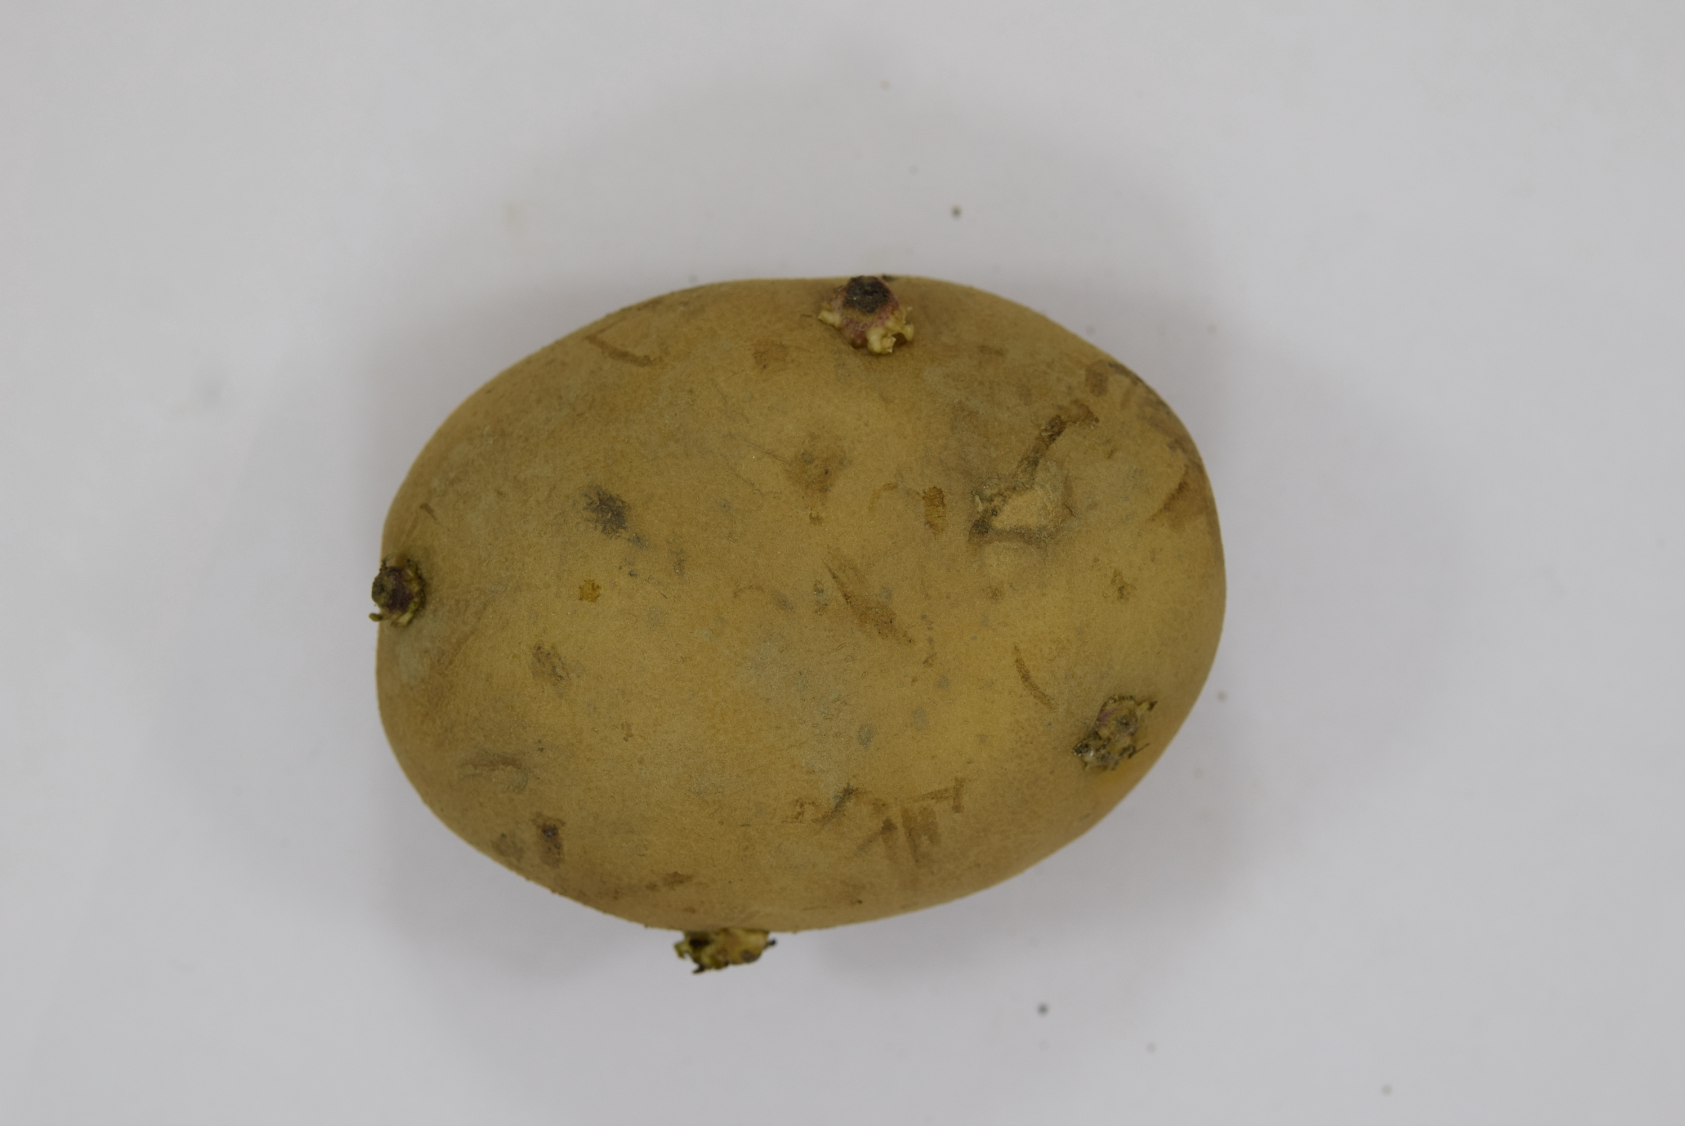
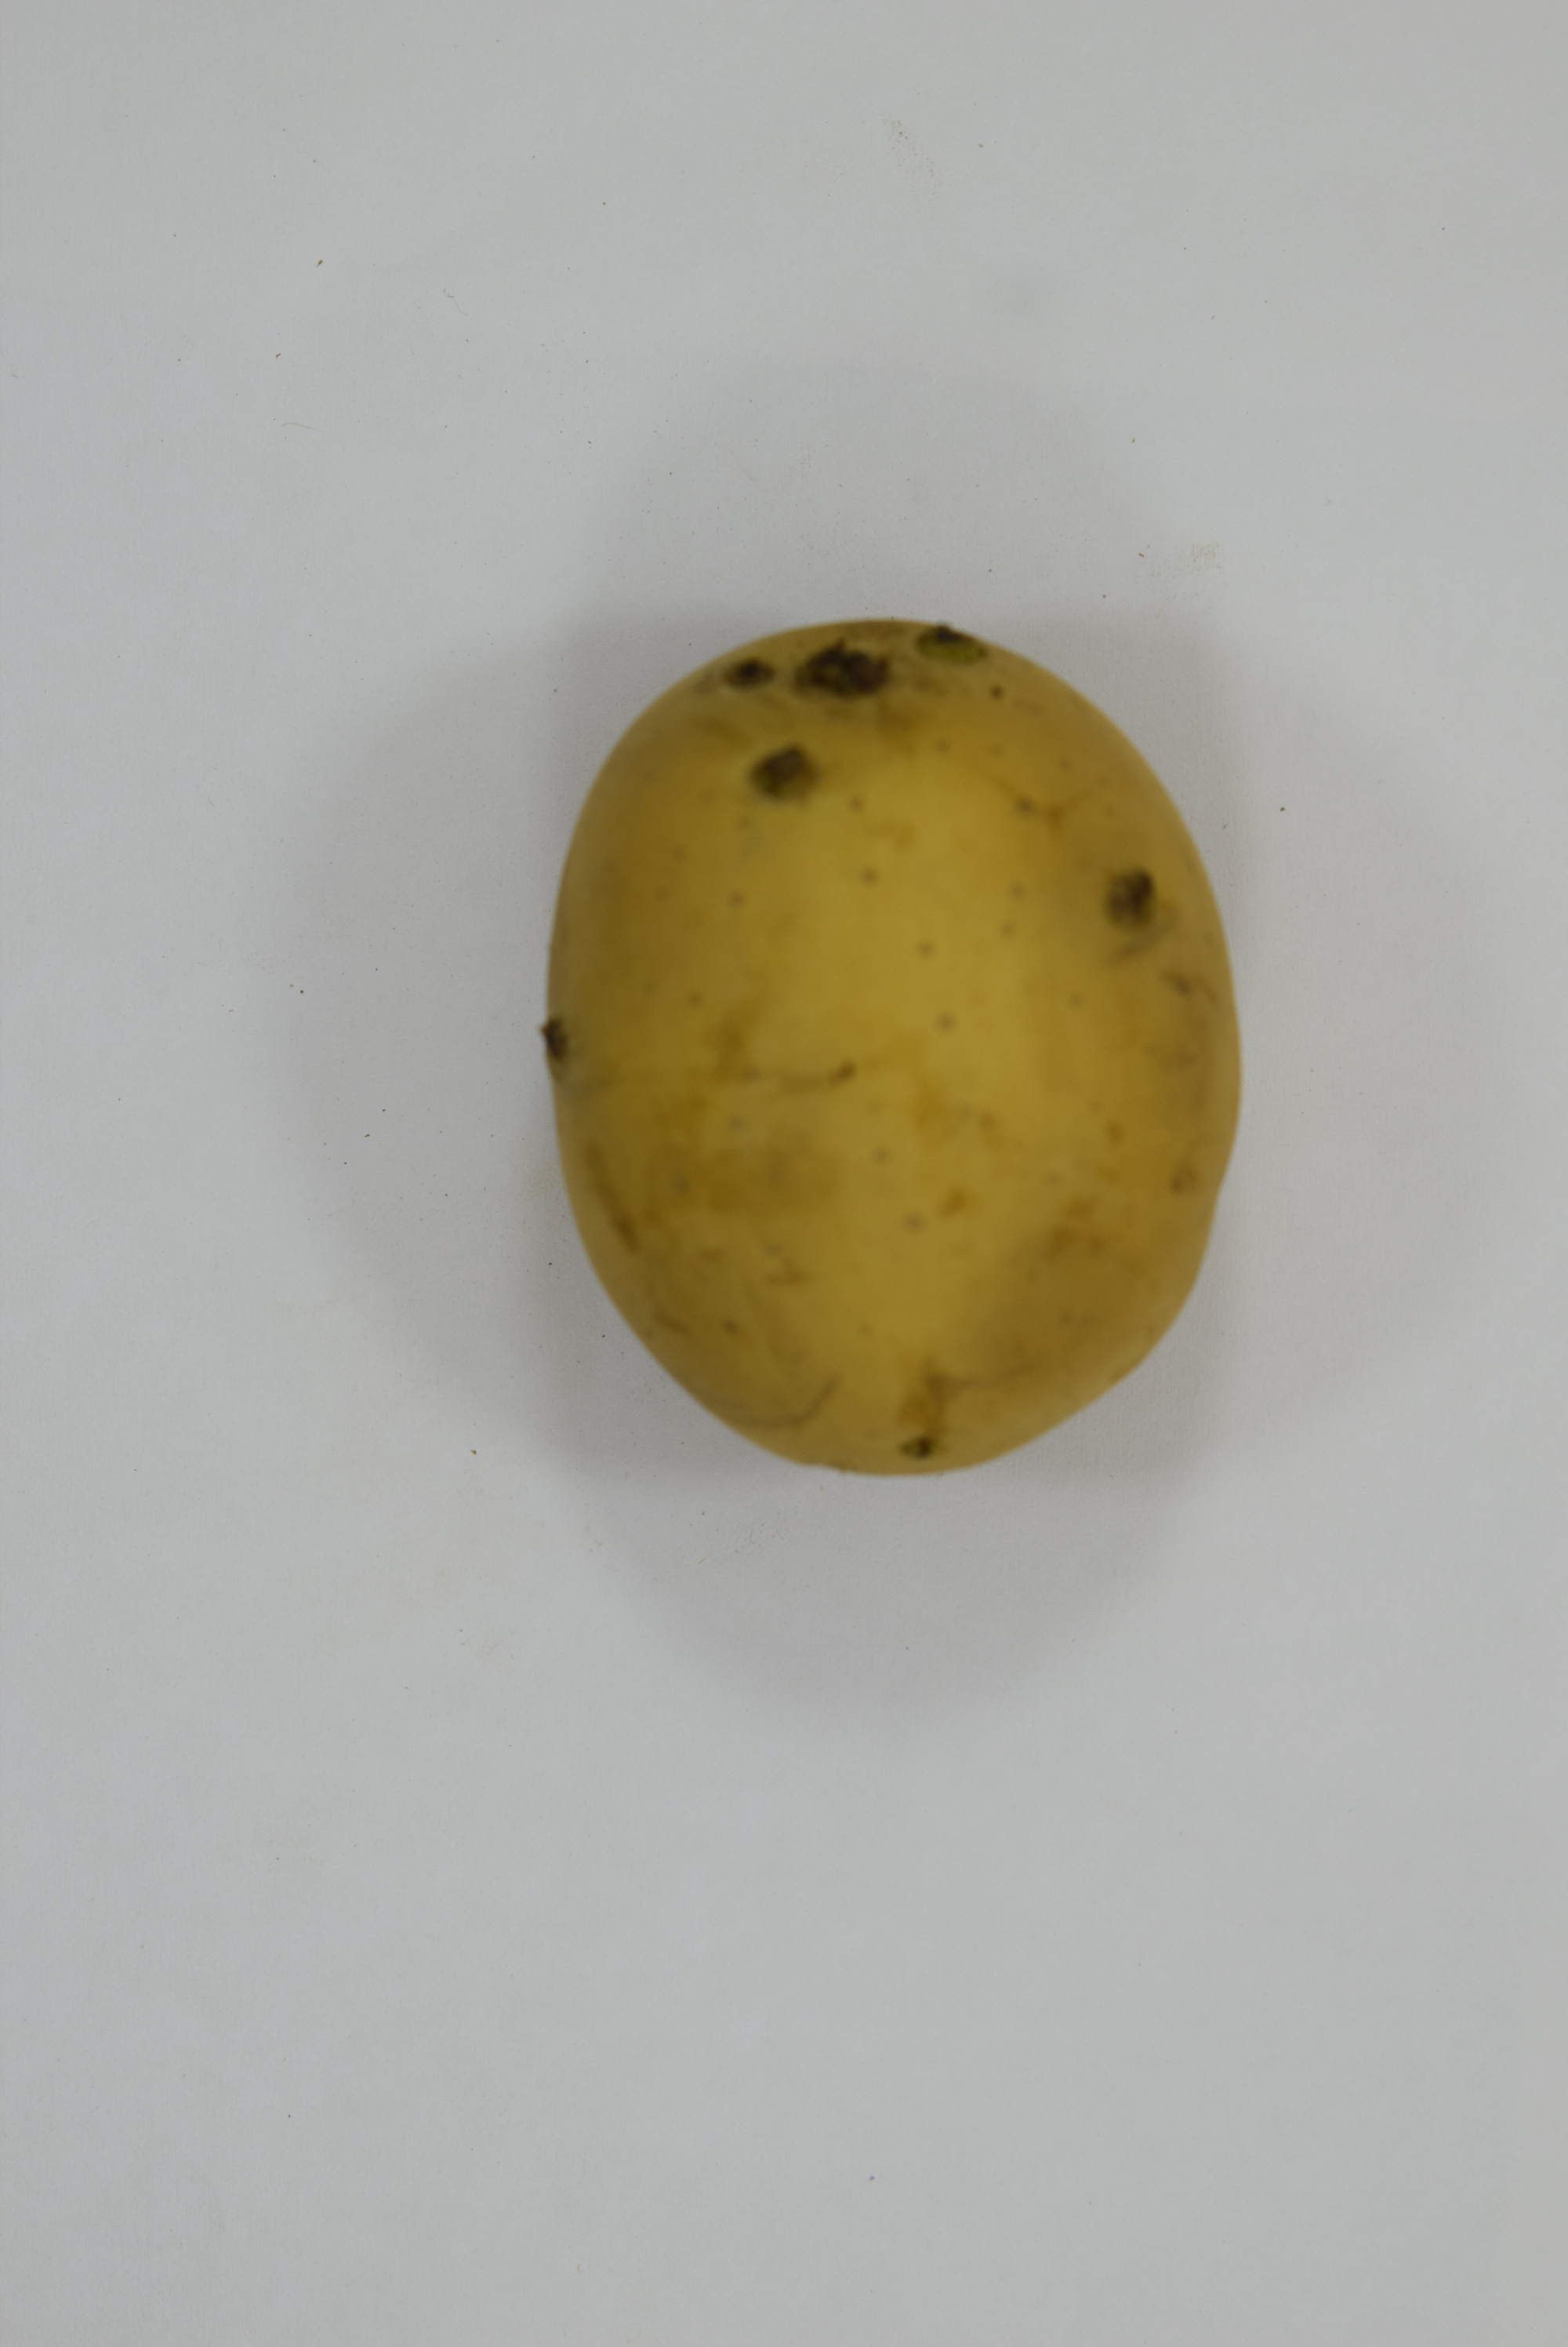
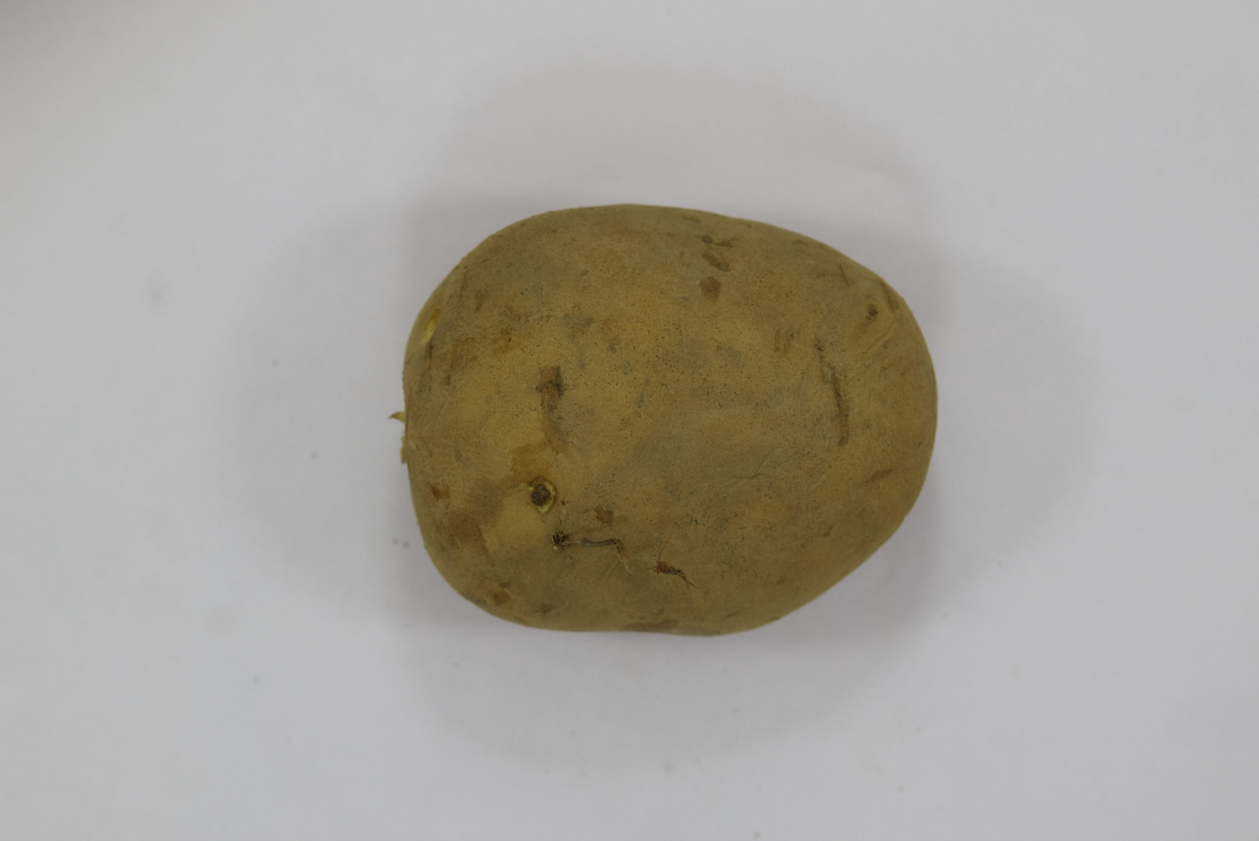
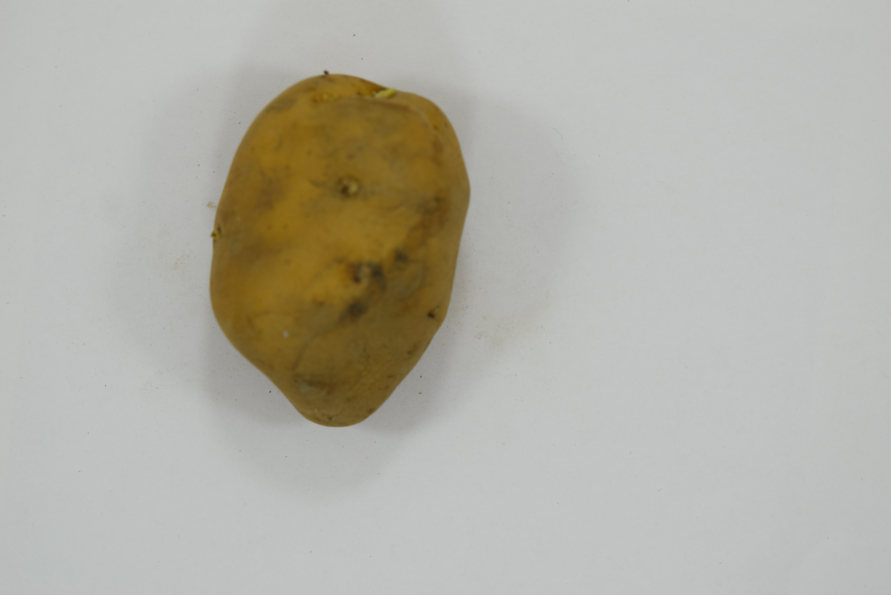
Potato Varieties Use in the Project
Chandramukhi
Chipsona3
Ganga
Garima
Gourav
Jyoti
Hemalini
Khatti

Slide 7
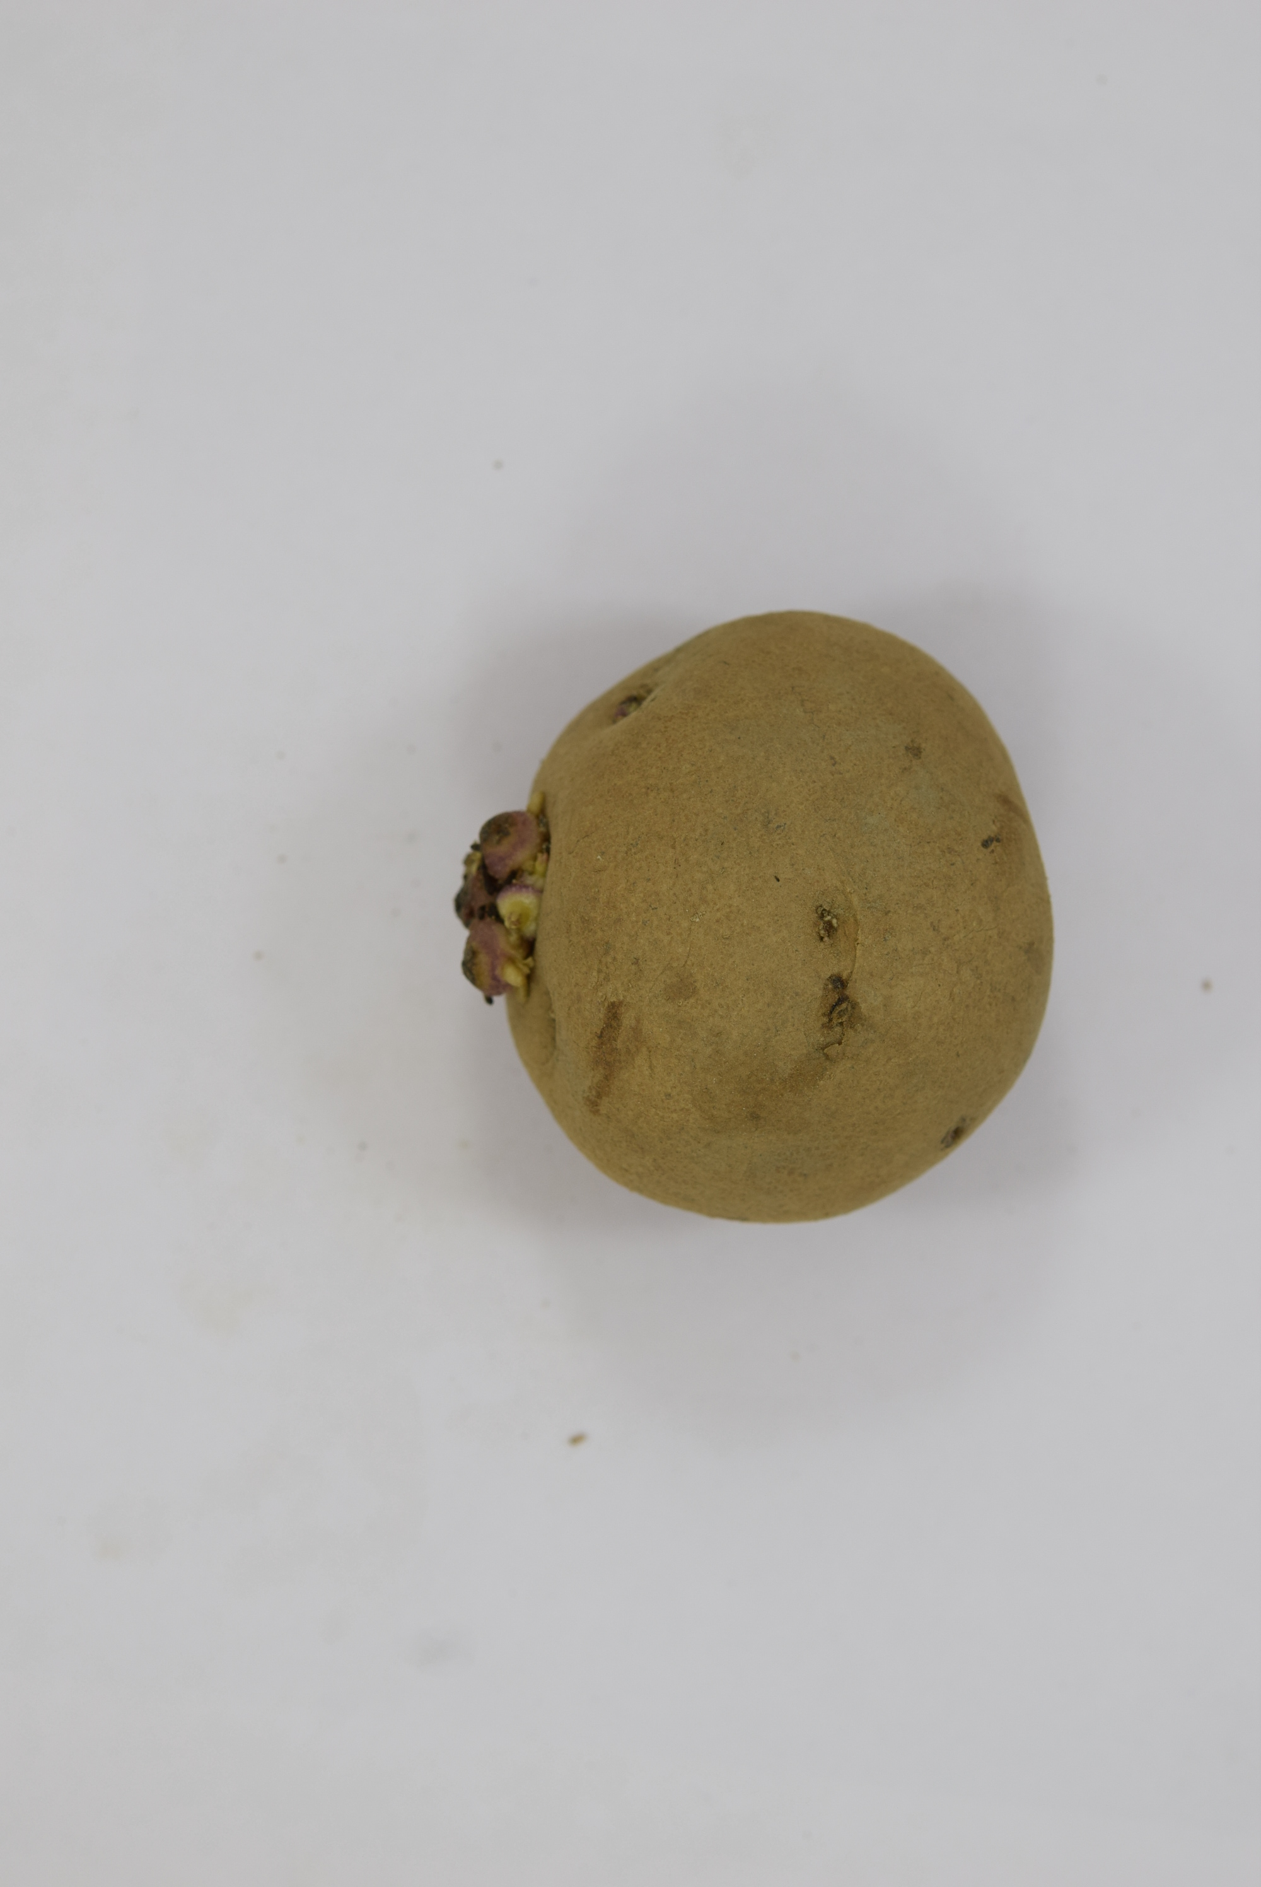
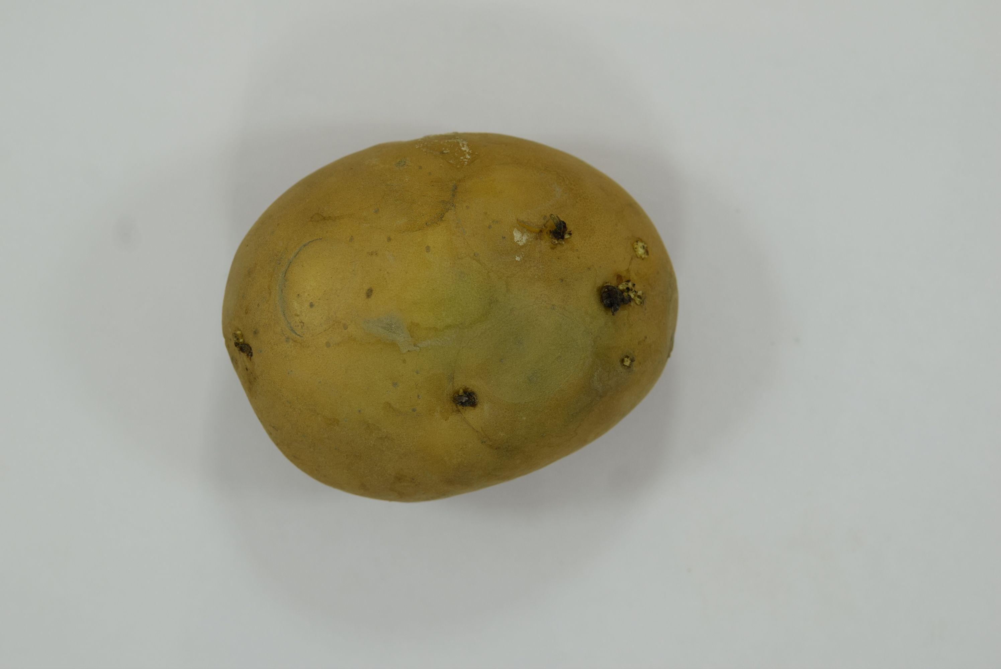
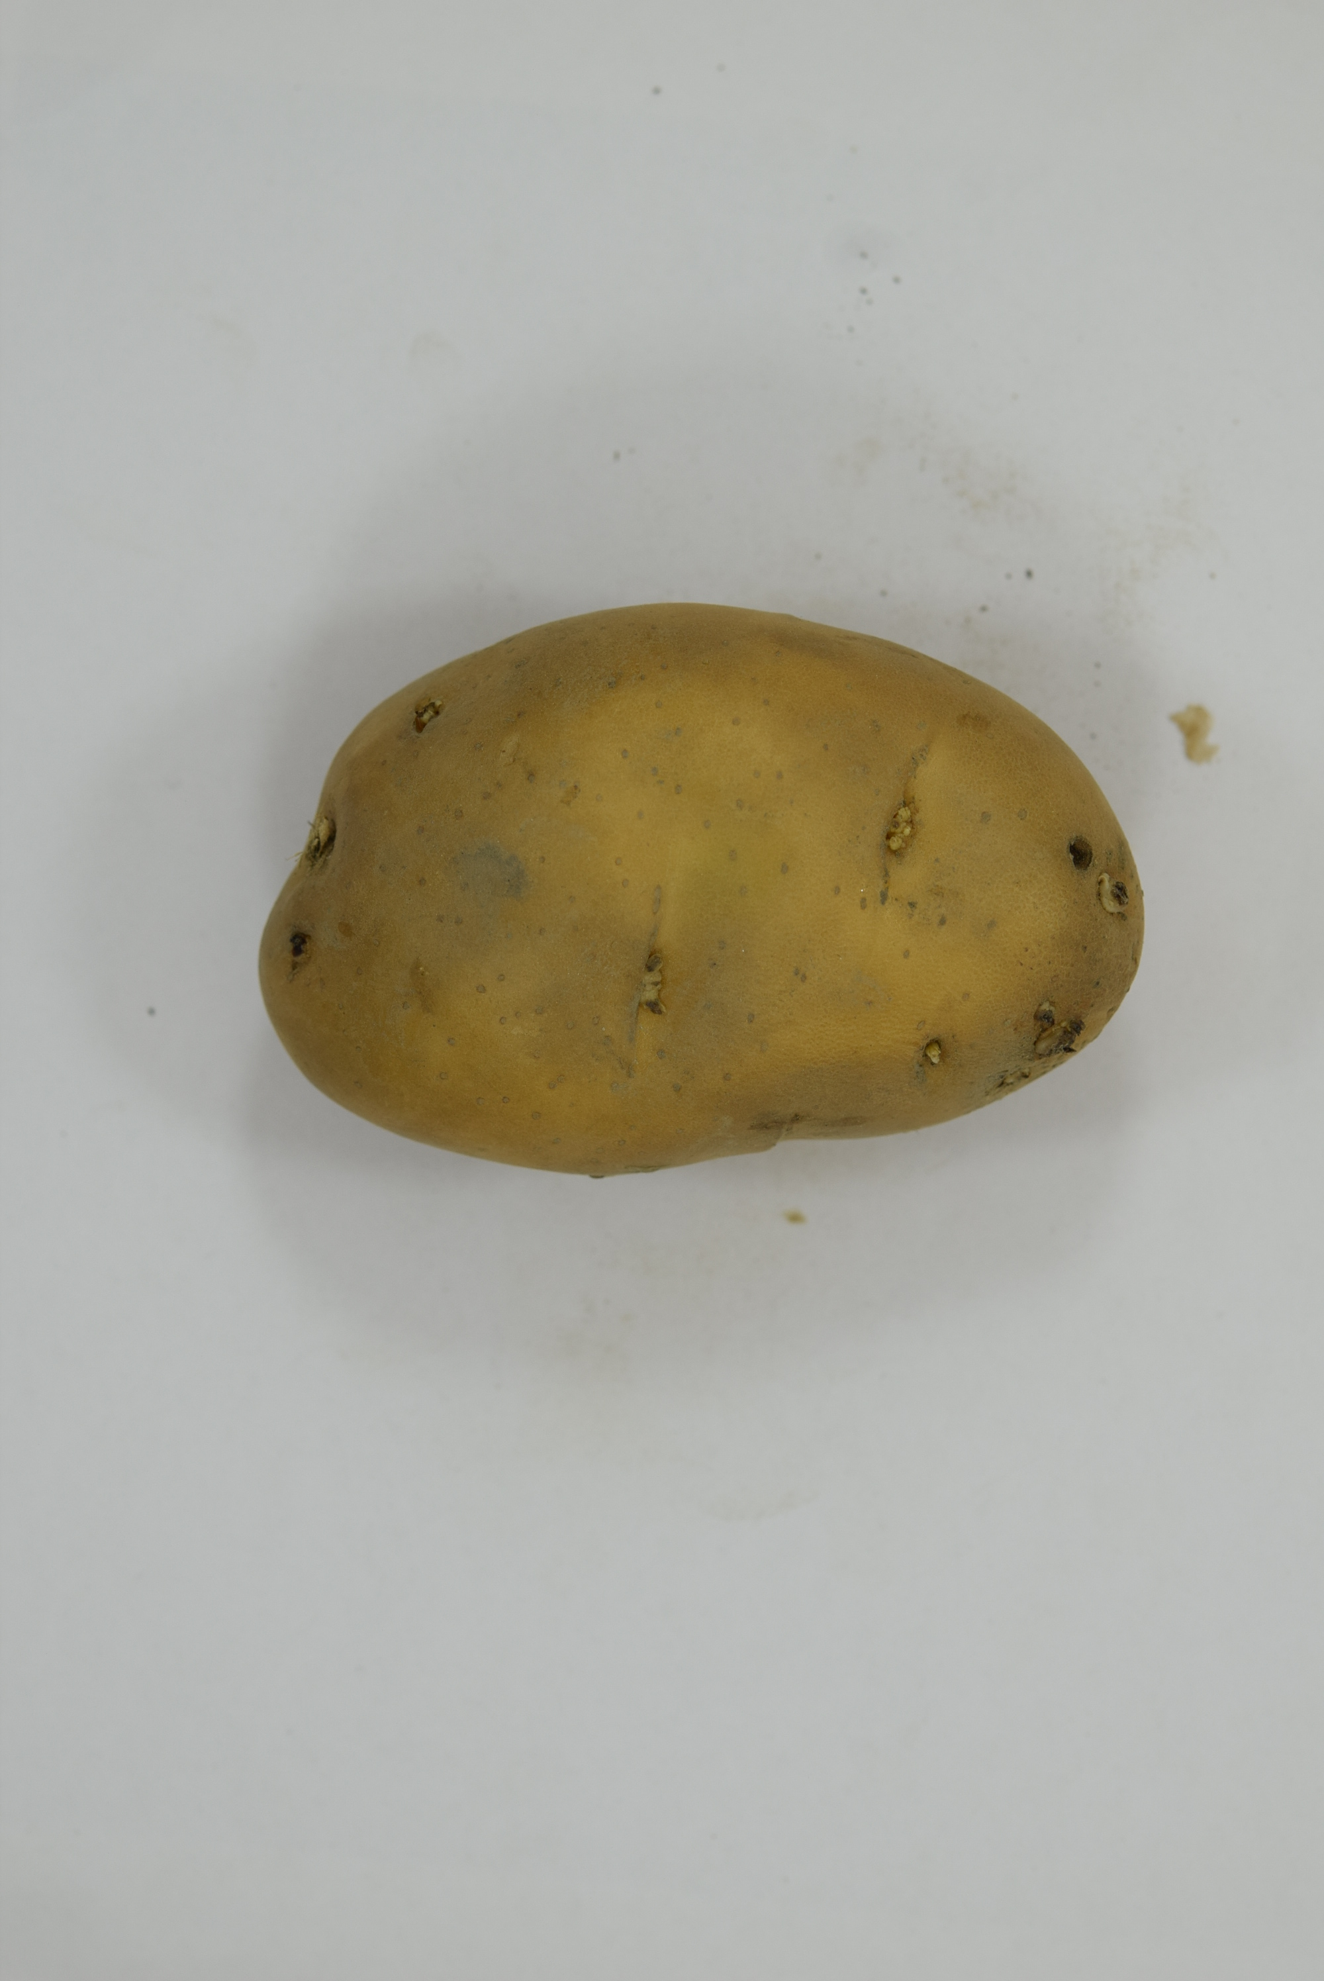
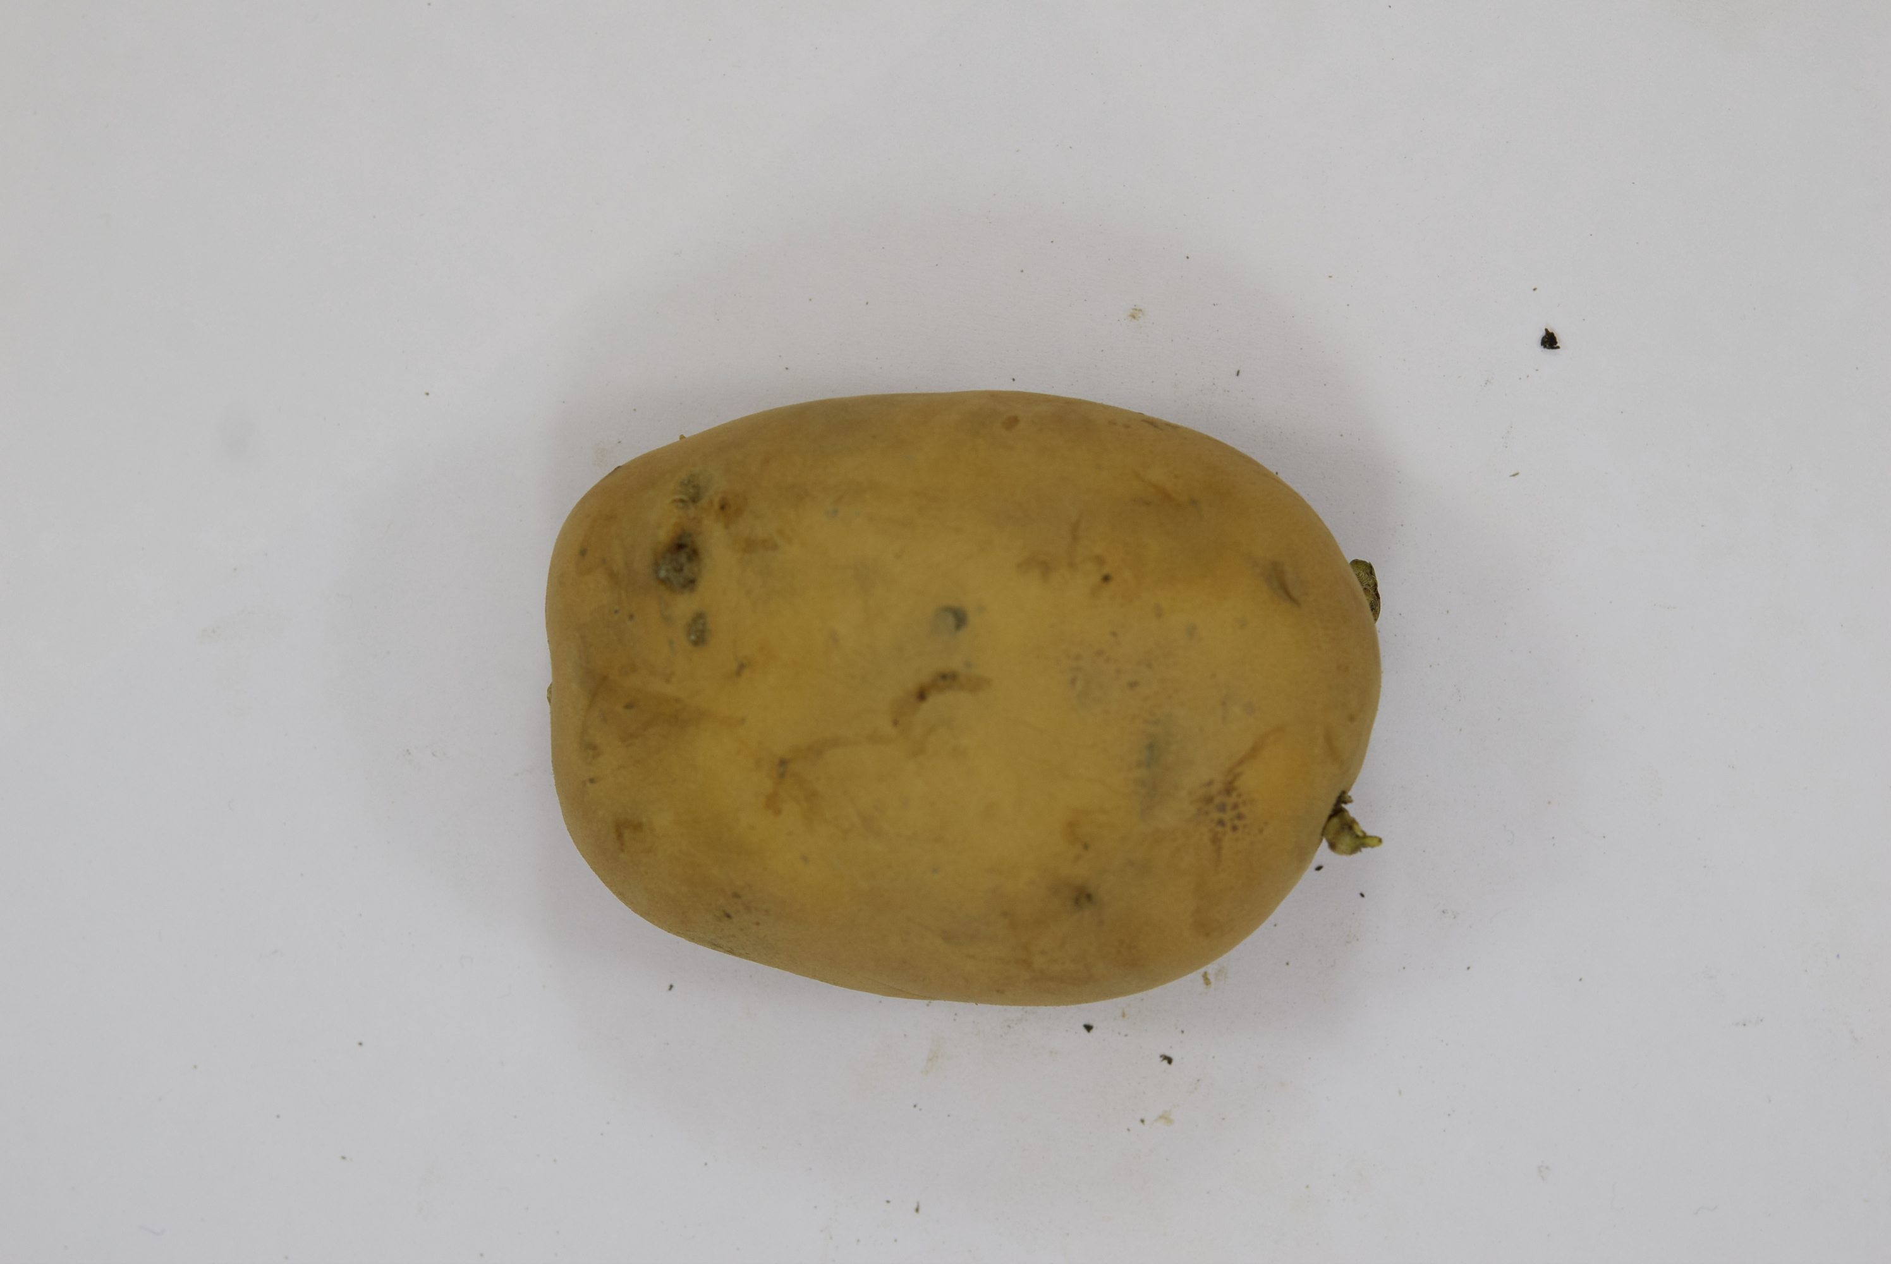
Lalima
Mohan
Pokhraj
Puskar

Slide 8
Architecture (Image Classification Model)
Perfect photo of a Potato
Taking the image
CNN
Feature Extraction
Training (80%)
Testing (20%)
Potato Identification

Slide 9
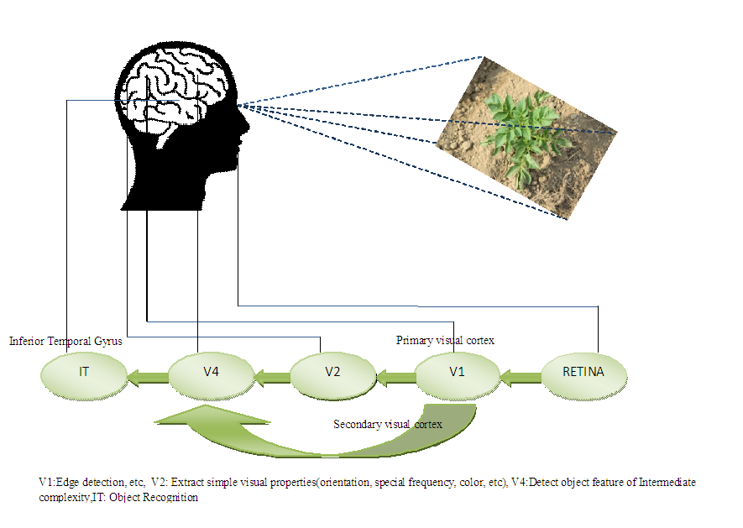
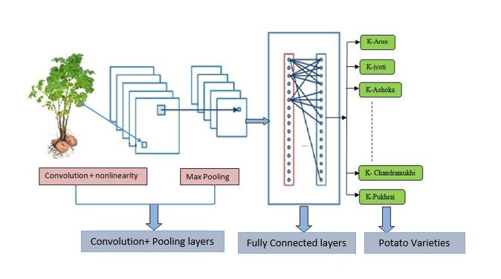
Potato Variety Identification using Convolution Neural Network
The Convolution neural network for potato varieties classifications
Human visual cortex system

Slide 10
Features extract from the Image
Contrast, Homogeneity, Energy, Correlation
Texture Features
Shape Features
Color Histogram

Slide 11
Training the Model
Data Pre-Processing
Feature Export
Feature extraction and dataset Pre-processing
Model Evaluation and Saving
Normalization and Standardization
Model Architecture Creation
Model Training

Slide 12
Testing the Model
Feature Extraction from images
Pre-processing and Image Preparation
Model Prediction and Inference
Scaling and Normalization
Feature Extraction

Slide 13
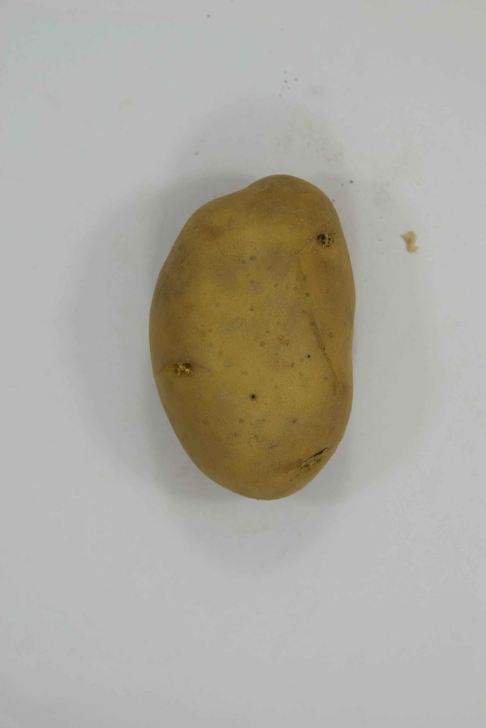
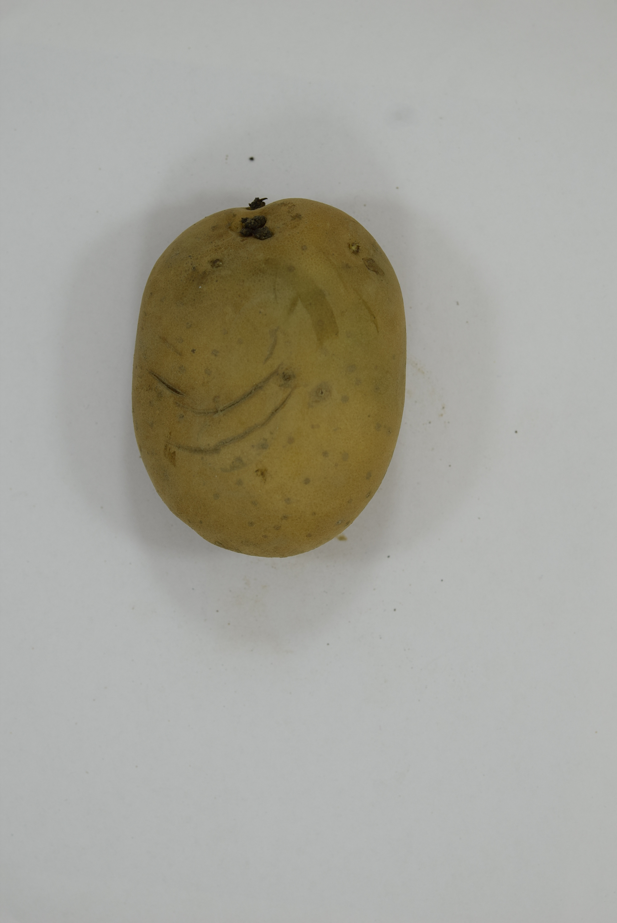
CNN Using Image features
Training
Testing
……...
Training Image
Test Image
Image features of each training images of training image set
Image features
Classification using Convolution Neural Network using image features
Prediction model
Predict The potato Class

Slide 14
Potato Image Database
Potato Varity | Mode | Number of Training Image | Number of Testing Image
Ganga | DSLR/Mobile | 268 | 30
Chandramukhi | DSLR/Mobile | 267 | 30
Chipsona3 | DSLR/Mobile | 233 | 30
Garima | DSLR/Mobile | 368 | 30
Gourav | DSLR/Mobile | 285 | 30
Hamlini | DSLR/Mobile | 284 | 30
Jyoti | DSLR/Mobile | 346 | 30
Khatti | DSLR/Mobile | 270 | 30
Lalima | DSLR/Mobile | 359 | 30
Puskar | DSLR/Mobile | 328 | 30
Mohan | DSLR/Mobile | 328 | 30
Pokhraj | DSLR/Mobile | 320 | 30

Slide 15
Testing Result
Potato Varity | Number of Correct Prediction | Total number of Testing Image
Chandramukhi | 29 | 30
Pokhraj | 29 | 30
Garima | 29 | 30
Jyoti | 30 | 30
Mohan | 23 | 30
Chipsona | 30 | 30
Ganga | 30 | 30
Gourav | 29 | 30
Hemalini | 30 | 30
Khatti | 29 | 30
Lalima | 30 | 30
Puskar | 28 | 30

Slide 16
Limitation
Dataset Imbalance: Unequal class distribution can lead to biased predictions.
Image Quality Dependency: Poor lighting or low-resolution images may reduce accuracy.
Overfitting Risk: The model may perform poorly on unseen data if not regularized properly.
High Computational Needs: Training and deploying CNNs require significant resources.

Slide 17
Conclusion
This potato classification project demonstrates the effectiveness of deep learning in agriculture.
Proper preprocessing and dataset preparation play a crucial role in achieving high model accuracy.
The implementation of CNNs ensures precise identification of potato diseases based on image data.
Despite its accuracy, the method is resource-intensive and depends on high-quality data.
The integration with a web application enhances usability for farmers and agricultural experts.
With further optimization, this model can be scaled to other crops and diseases for broader impact.

Slide 18
References
Cheng, Y., Xie, Z., & Liu, J. (2021). "Automated potato classification using machine learning techniques." Computers and Electronics in Agriculture, 180, 105890.
Gonzalez, R.C., & Woods, R.E. (2008). Digital Image Processing (3rd ed.). Pearson.
Haralick, R.M., Shanmugam, K., & Dinstein, I. (1973). "Textural Features for Image Classification." IEEE Transactions on Systems, Man, and Cybernetics, SMC-3(6), 610621.
Krizhevsky, A., Sutskever, I., & Hinton, G.E. (2012). "ImageNet classification with deep convolutional neural networks." In Advances in Neural Information Processing Systems (pp. 1097–1105).
LeCun, Y., Bengio, Y., & Hinton, G. (2015). "Deep learning." Nature, 521(7553), 436444.
Patel, D., Jadhav, M., & Prasad, R. (2020). "Potato variety classification using deep learning and image processing techniques." Agricultural Systems, 181, 102790.
Perez, L., & Wang, J. (2017). "The effectiveness of data augmentation in image classification using deep learning." Convolutional Neural Networks for Visual Recognition.
Raj, R., Kumar, R., & Pandey, A. (2019). "Machine learning applications in agriculture." Journal of Agricultural Engineering, 56(4), 132-145.
Sahoo, D., & Ghosal, S. (2020). "Hybrid techniques for machine learning in agriculture." Journal of Agricultural Engineering, 47(1), 31-46.
Zhang, Z., & Wang, Y. (2019). "Hybrid deep learning models for automated agricultural systems." Computers and Electronics in Agriculture, 162, 121-129.

Slide 19
Thank You

